Slide 1
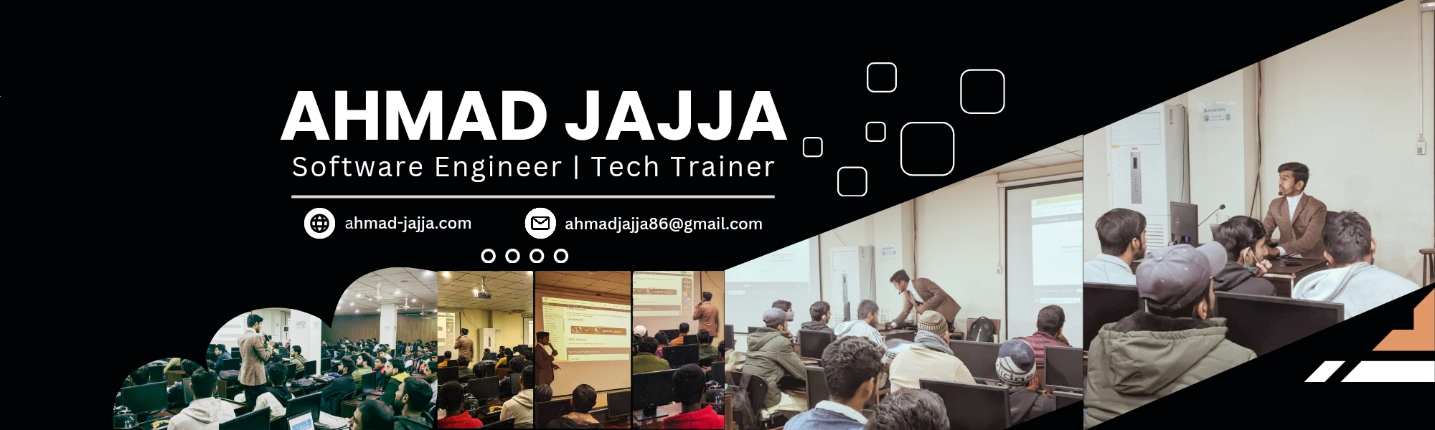
AI and Data Science (Orientation)
A Journey From Faisalabad to USA

Slide 2
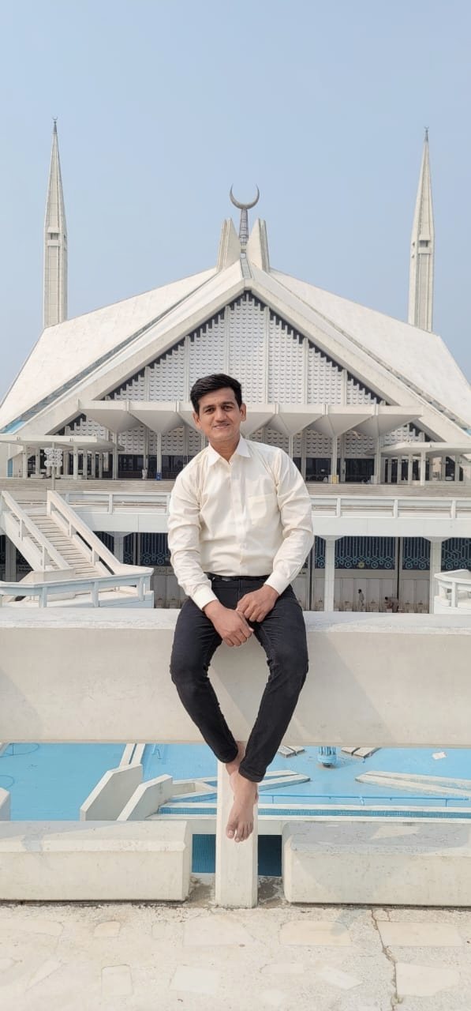
Who am I?
Ahmad Jajja (Ahmad Sultan)
Software Engineer & Trainer (taught 1000+ students)
Worked at some local companies in Faisalabad.
Co-Founder & Development Lead at EcoFactor
BS in Computer Science (Univ. of Agri, Faisalabad)
CGPA: 3.35/4.0
Upcoming Role: Teaching Assistant at Montana State University (Spring 2025)

Slide 3
Few more things
Language Proficiency:
Duolingo English Test: 125/160
IELTS: 6.0/9.0
Achievements:
Participated in 5+ international hackathons
Solved 300+ Leetcode problems
Typing speed around 100 wpm
Section Leader at Stanford’s Code In Place
Documents:
Letters of Recommendation (USA, Brazil, Pakistan)
Statement of Purpose (SOP)

Slide 4
Journey of Self-Development
Sharing personal experiences; open to disagreement.
How Allah cleared my path.
Growth begins with understanding life’s core reality.
You only need one reason to work, but I have multiple.

Slide 5
Matric Life (2016 - 2018)
Studied in Government Urdu Medium School.
Scored 880/1100.
Failure in Biology led to pursuing Computer Science.

Slide 6
Intermediate Studies (2018-2020)
Influential teacher: Ishaq Sehrai (Quaid-e-Azam University graduate).
In-depth understanding of C language.
Marks: 198/200 in Computer Science; Overall 909/1100.

Slide 7
Thought Process After Intermediate (2020)
Initially planned to join a local school for BSc.
Family encouraged me to attend university.
Joined University of Agriculture, Faisalabad in 2020 to study Computer Science.

Slide 8
University Life (Year 1) 2020 - 2021
Life-changing meetup with Faizan Amin on Orientation Day.
Learning coding on mobile during COVID.
Aimed for FAANG.
Moved to the city inspired by:
Visited software houses in Faisalabad.
Used to do Programming whole nights.

Slide 9
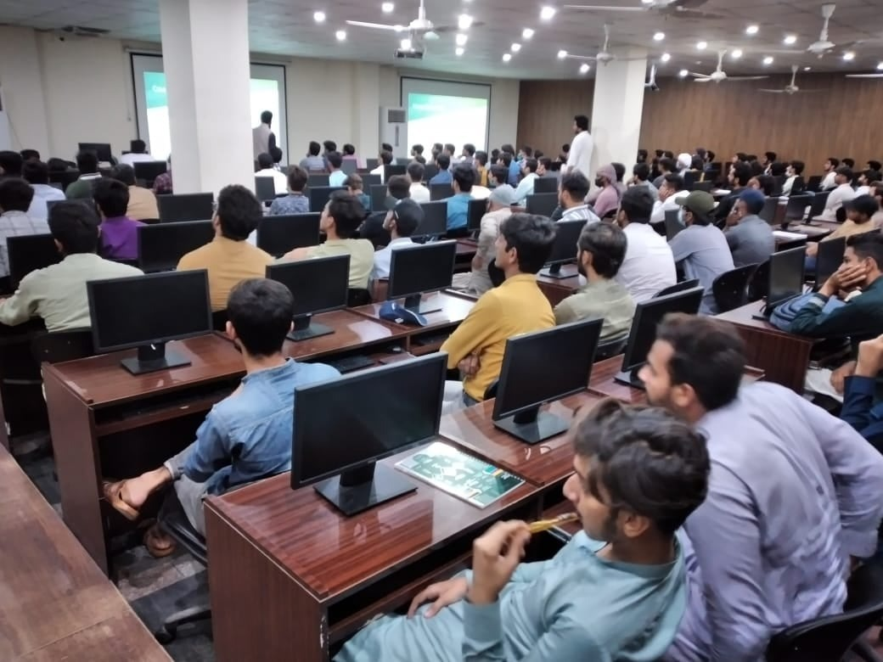
University Life (Year 2) 2021 - 2022
Joined SMIT as a student.
Shifted focus from FAANG to entrepreneurship.
Weekdays for university classes, weekends for SMIT classes.
Stayed away from family for the entire year.
Brief distraction in the 4th semester, but refocused.
Ranked in the top 5 out of 800 students at SMIT's final hackathon.

Slide 10
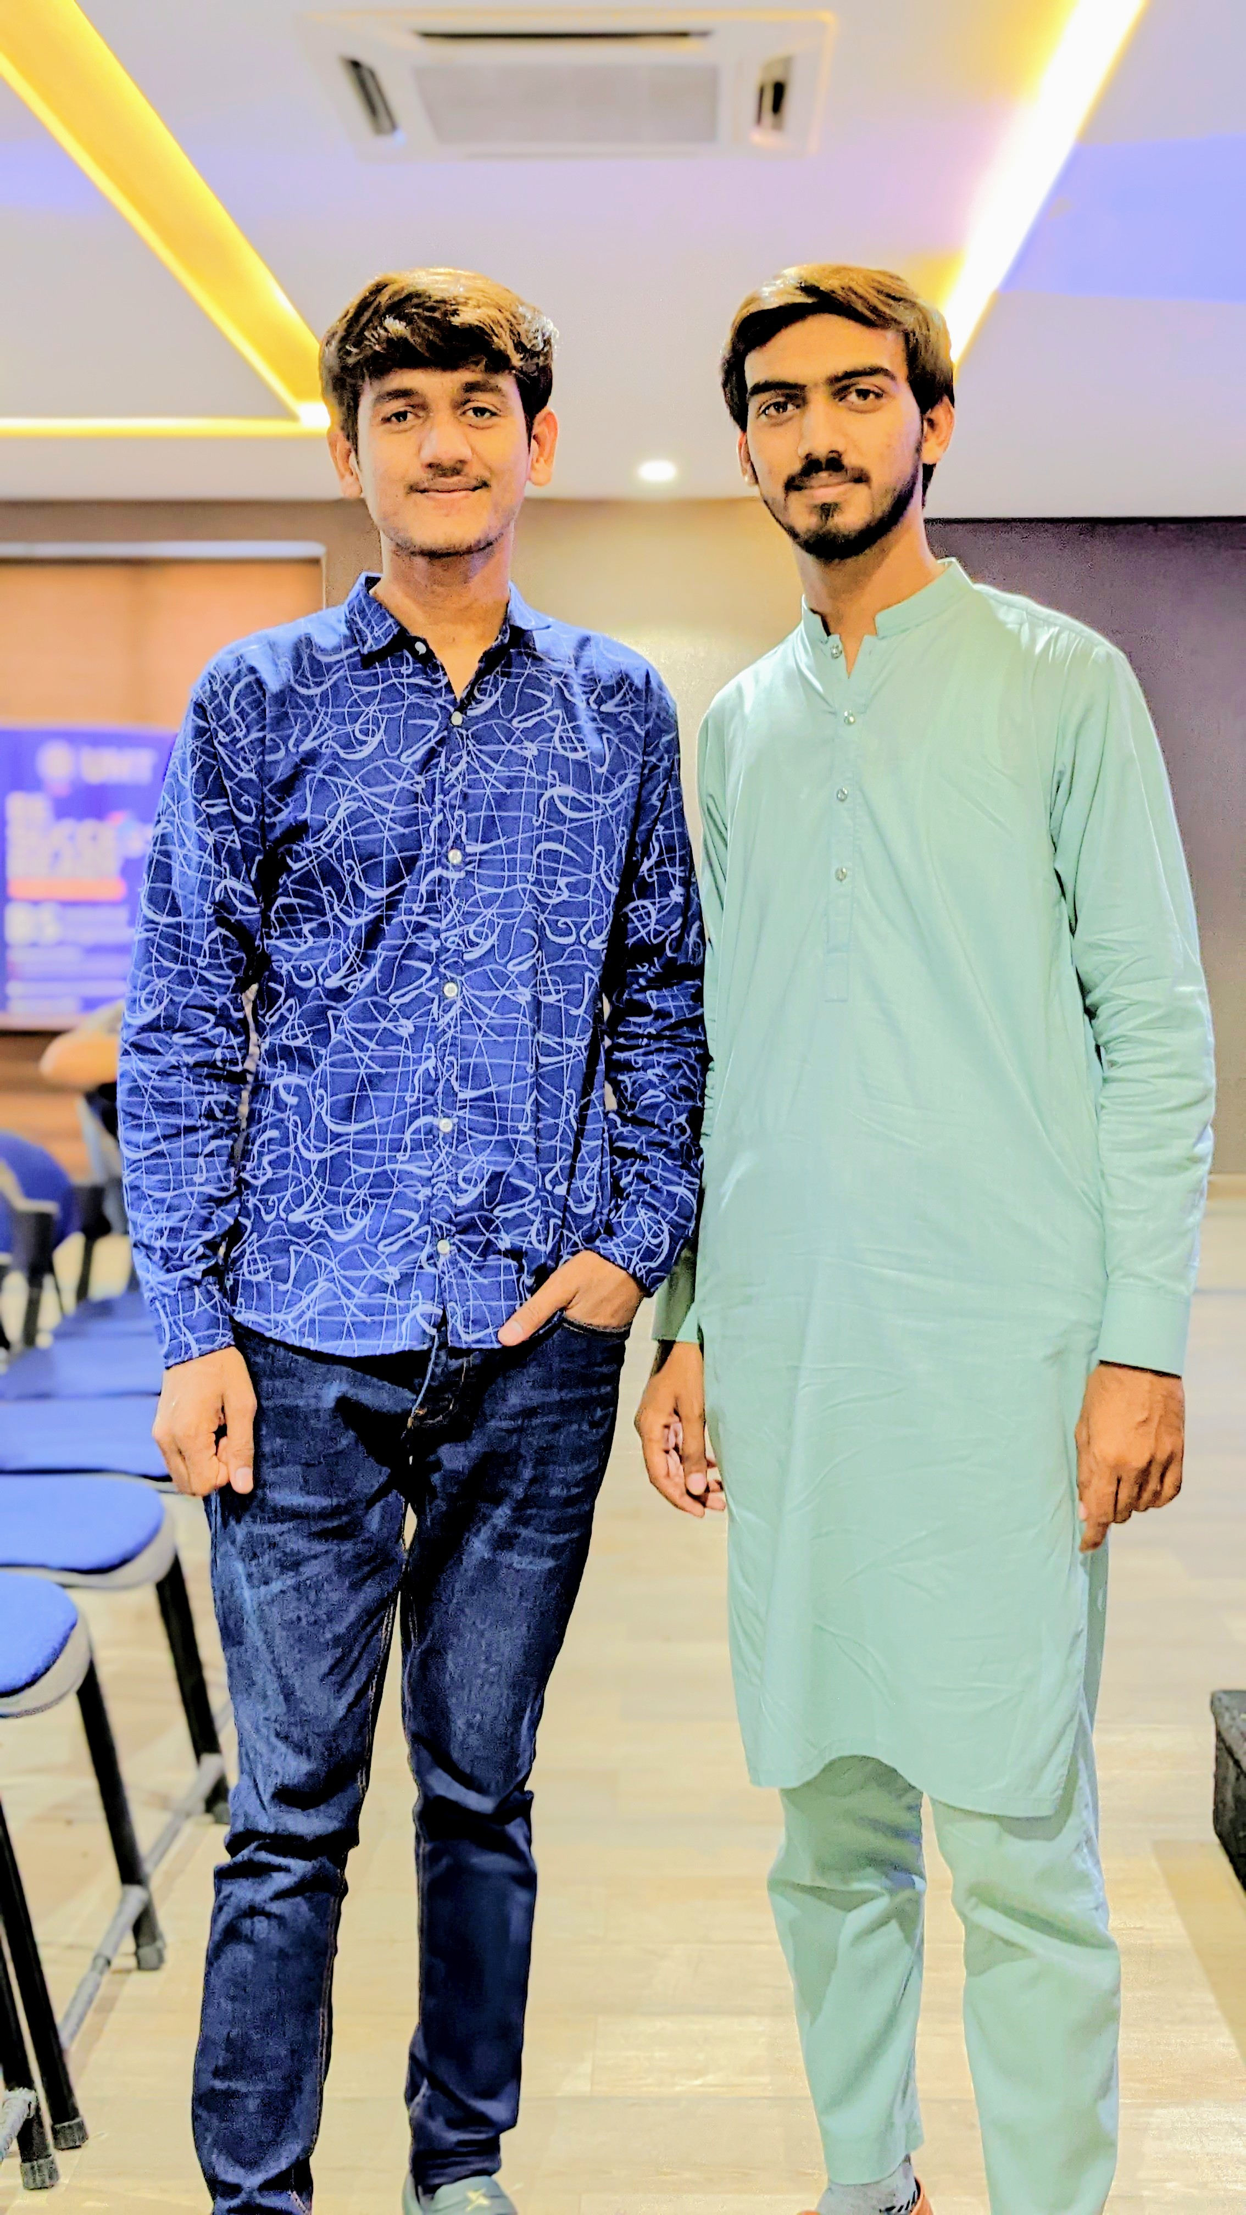
University Life (Year 3) 2022 - 2023
Joined PIAIC on October 2, 2022 in UMT Lahore.
Started teaching at SMIT.
Began job as a full stack developer.
Solved 200+ Leetcode problems, aiming for 1000+.
Focus on interviews affected GPA significantly 1.6/4.0.
Current GPA: 2.97/4.0 after the 6th semester.

Slide 11
University Life (Year 4) 2023 - 2024
Dr. Zafar’s Guidance
Stopped Leetcode, prepared for IELTS.
Joined hackathons and worked on improving GPA.
IELTS result: 6.0/9.0.
Duolingo result: 125/160.
Degree completed.

Slide 12
Post-Degree Journey 2024
Quickly prepared LORs, SOP, and CV.
Contacted professors but did not receive positive response for Spring 2025.
Estimated budget of 2 lakhs for 10 universities.
Reached out to professors and PhD students.
Accepted into Montana State University.

Slide 13
Visa Interview
Duration: 1-2 minutes.
Questions asked:
What, where, and why are you going to the US?
From where did you graduate?
Who is funding you?
Visa approved (blue slip handed).

Slide 14
Key Message
Do you need to do all the things I've done?
Simply No.
Key takeaway: Do the things that matter!

Slide 15
What Matters?
CGPA
Programming Skills (200-300 Leetcode questions are enough)
Hackathons and Coding Competitions (practical experience)
Teaching experience
Writing relevent content on LinkedIn

Slide 16
How much time do you need to Prepare?
1 year is sufficient if you start from scratch.

Slide 17
How to Prepare?
Be regular in classes, do the things accordingly.

Slide 18
Batches I taught?
Web and Mobile Application Development
Web Designing
AI and ChatBot
AI and Data Science

Slide 19
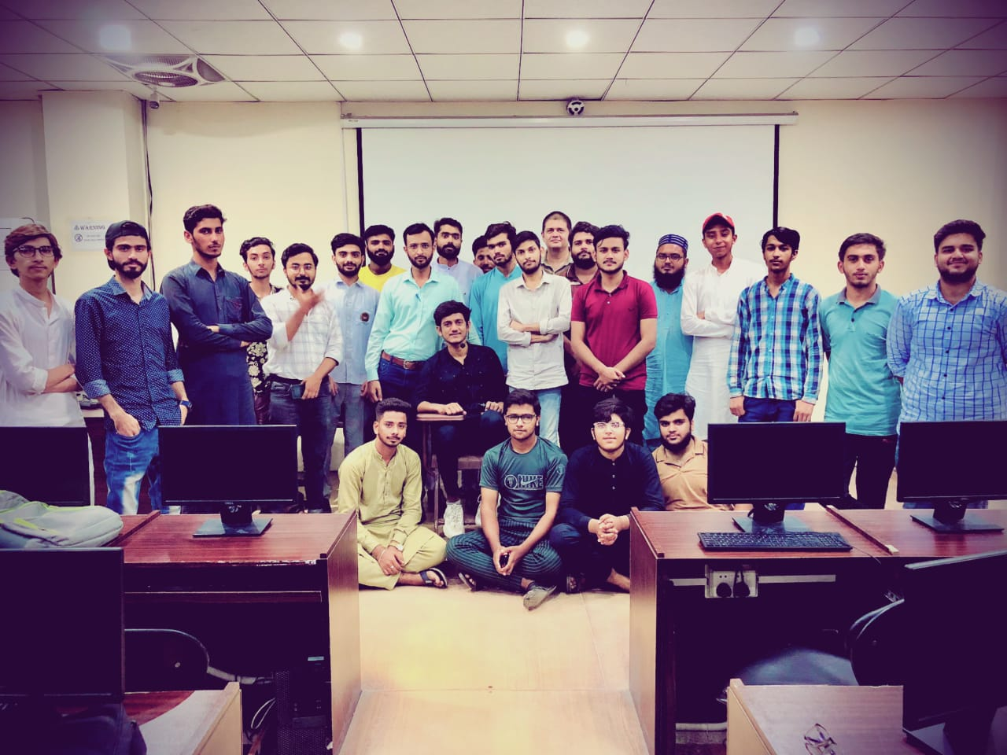
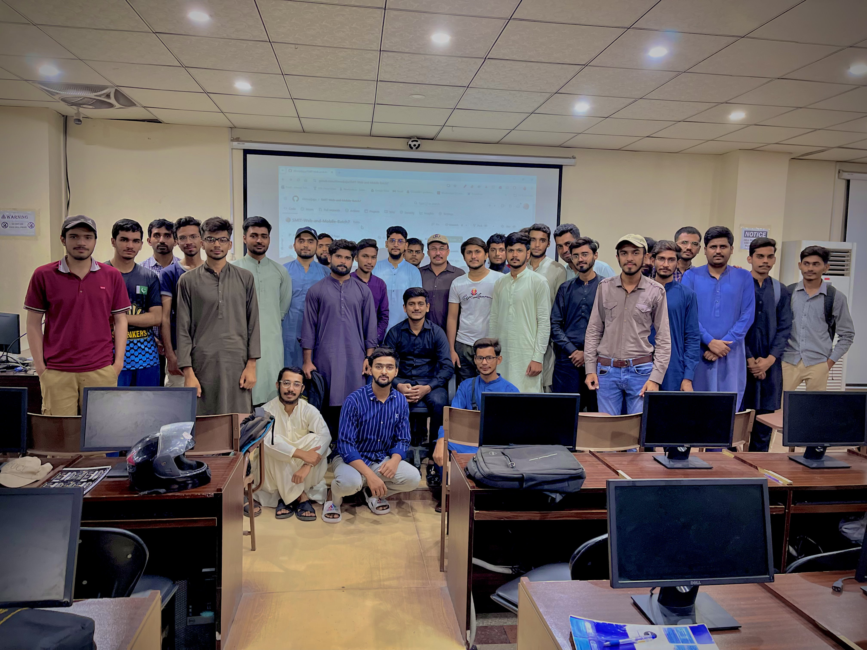
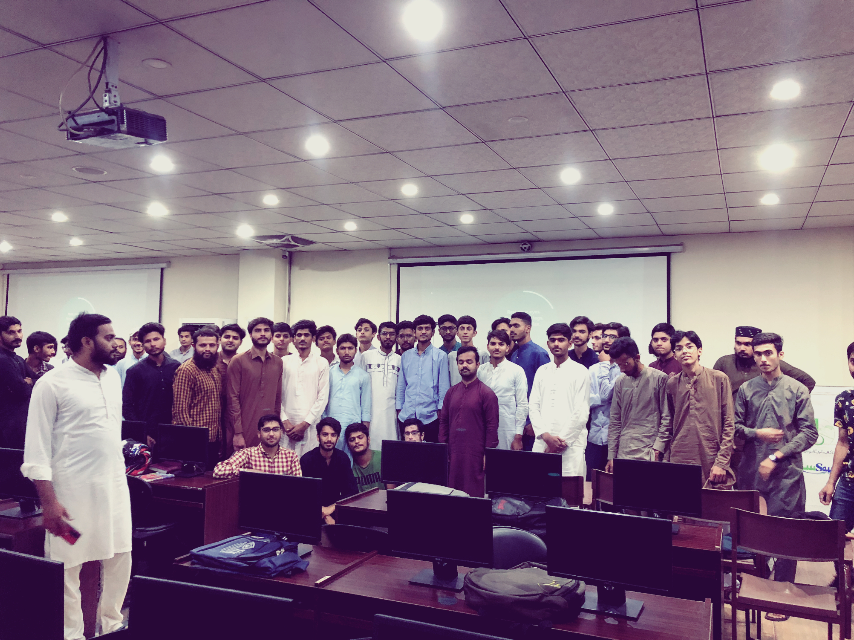
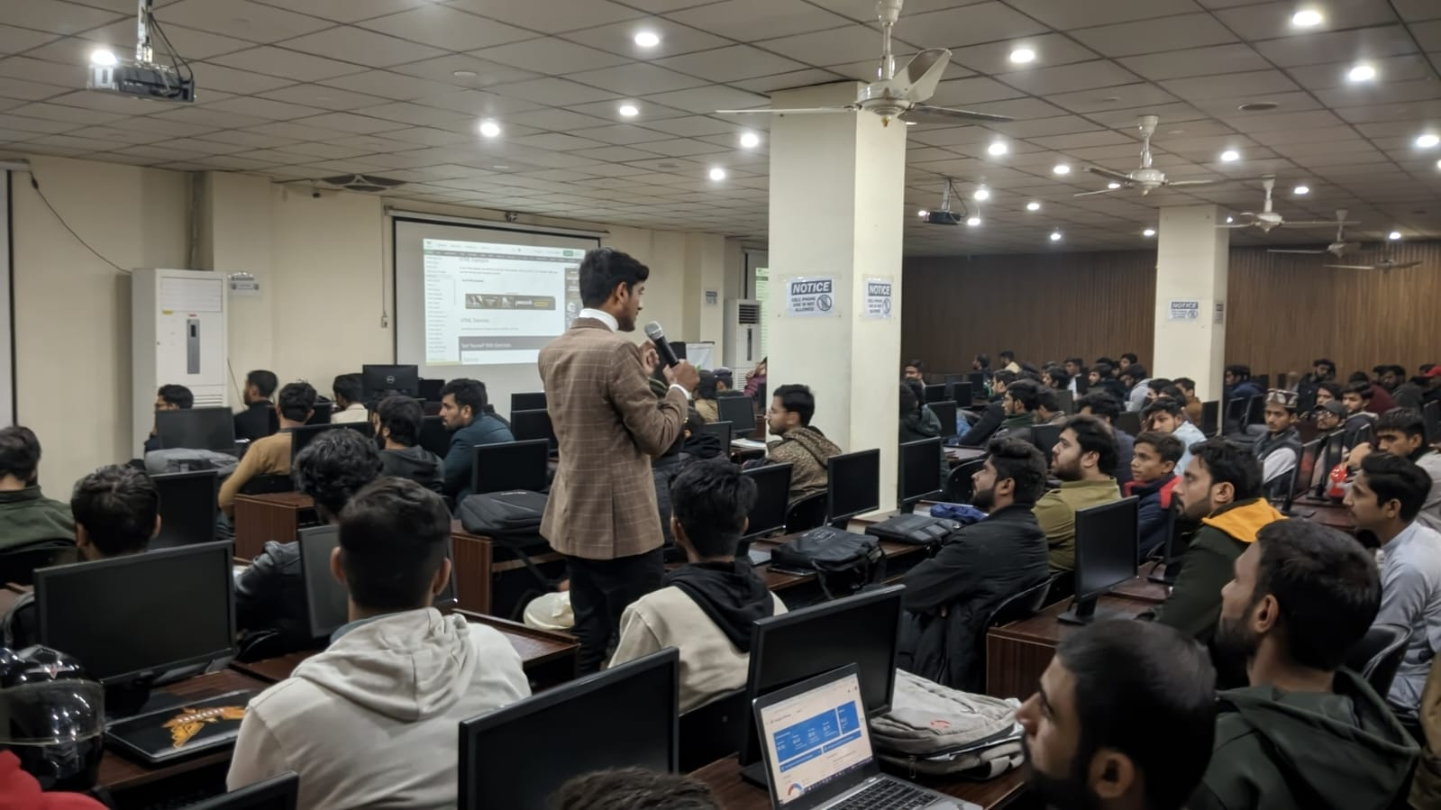
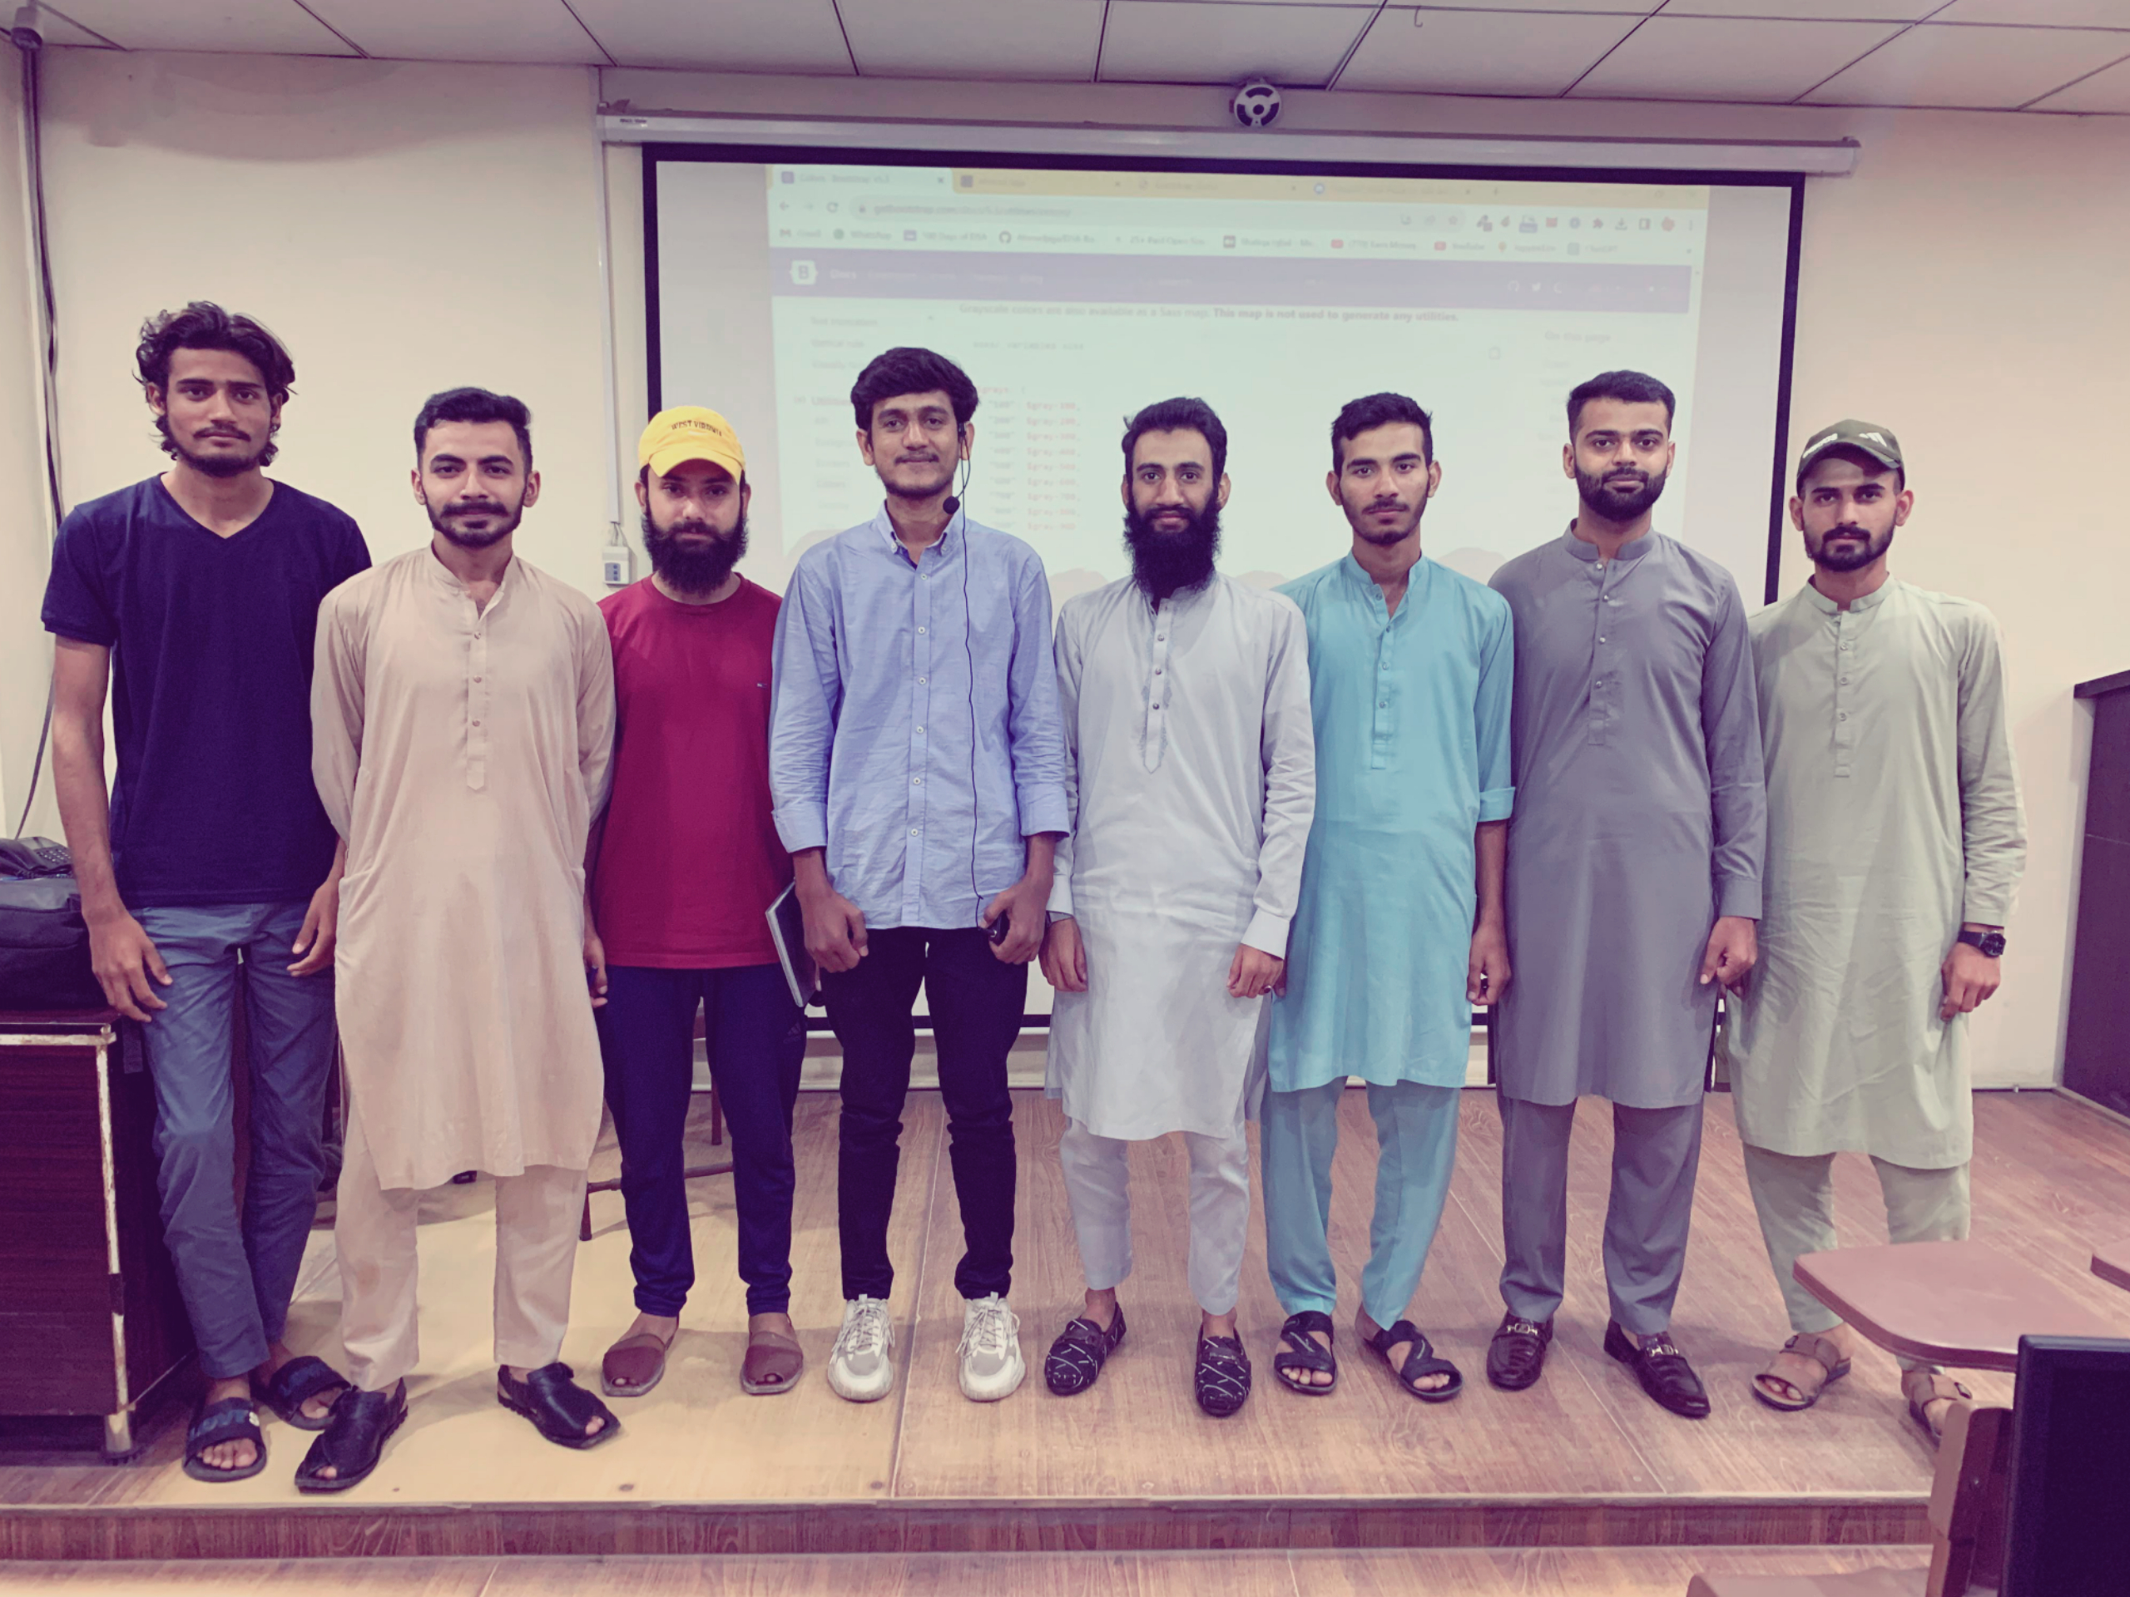
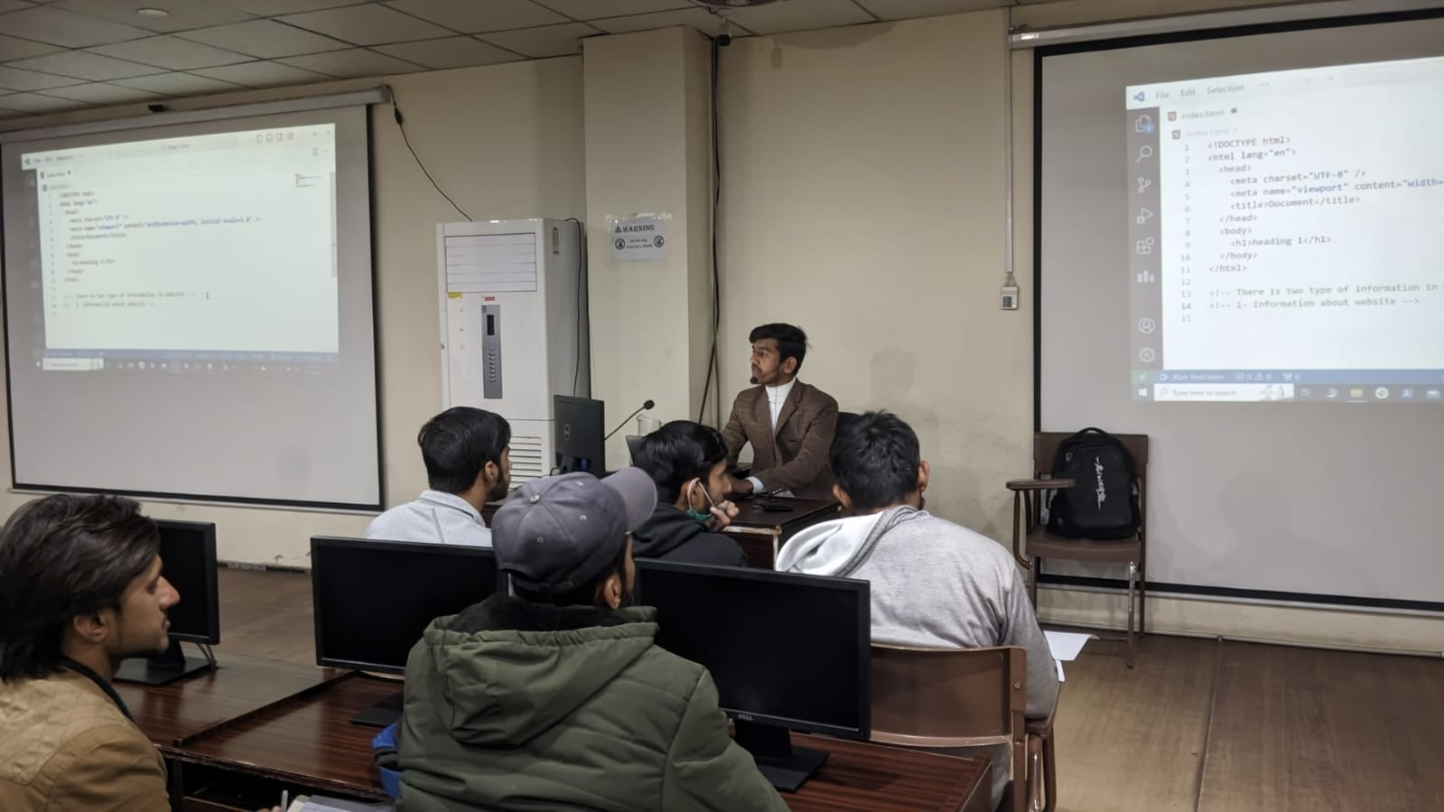
Some of the memories

Slide 20
AI and Data Science Course Content
Git & Github
Python programming language
Fast Api / Flask Server, Database(Postgres)
Langchain LLM(GPTs, Gemini)
Machine Learning, Deep Learning Theory
Sciket Learn, Numpy, Pandas, Matplotlib, Tensorflow (Keras)
Pytorch
Docker
Cloud (Aws, Google Cloud, Azure)

Slide 21
Questions & Connect
Questions? Feel free to ask!
Connect with me:
LinkedIn: https://linkedin.com/in/ahmad-jajja
GitHub: https://github.com/Ahmadjajja
Website: https://ahmad-jajja.com/
Instagram: https://www.instagram.com/__ahmadjajja__

Slide 22
Thank You

